Slide 1
CHAPTER 12:
General Rules of Probability
The Basic Practice of Statistics
6th Edition
Moore / Notz / Fligner
Lecture PowerPoint Slides
Notes:
Basic Practice of Statistics - 3rd Edition
Chapter 5

Slide 2
Chapter 12 Concepts
Independence and the Multiplication Rule
The General Addition Rule
Conditional Probability
The General Multiplication Rule
Tree Diagrams

Slide 3
Chapter 12 Objectives
Define independent events
Determine whether two events are independent
Apply the general addition rule
Define conditional probability
Compute conditional probabilities
Apply the general multiplication rule
Describe chance behavior with a tree diagram

Slide 4
Probability Rules
Everything in this chapter follows from the four rules we learned in Chapter 10:
Rule 1. The probability P(A) of any event A satisfies 0 ≤ P(A) ≤ 1.
Rule 2. If S is the sample space in a probability model, then P(S) = 1.
Rule 3. If A and B are disjoint, P(A or B) = P(A) + P(B).
This is the addition rule for disjoint events.
Rule 4. For any event A, P(A does not occur) = 1 – P(A).

Slide 5
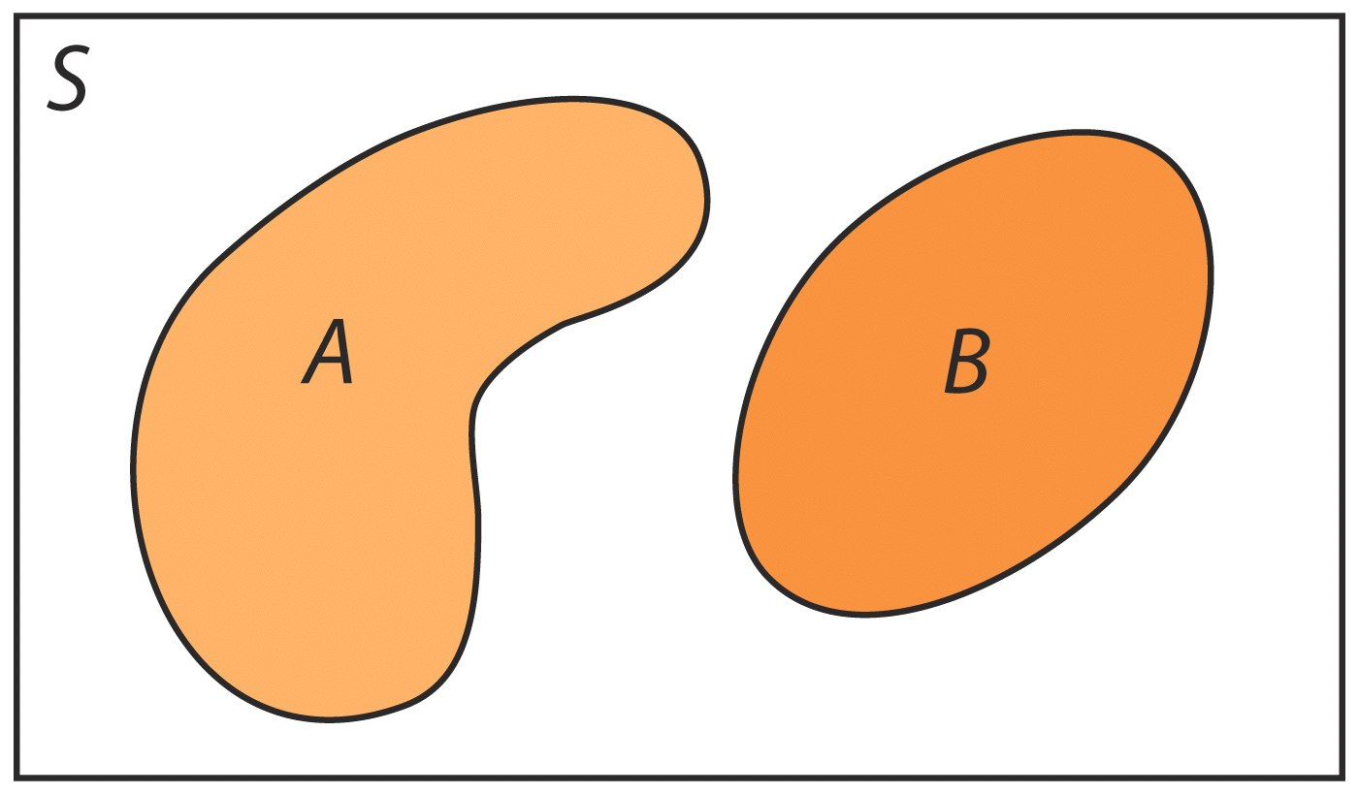
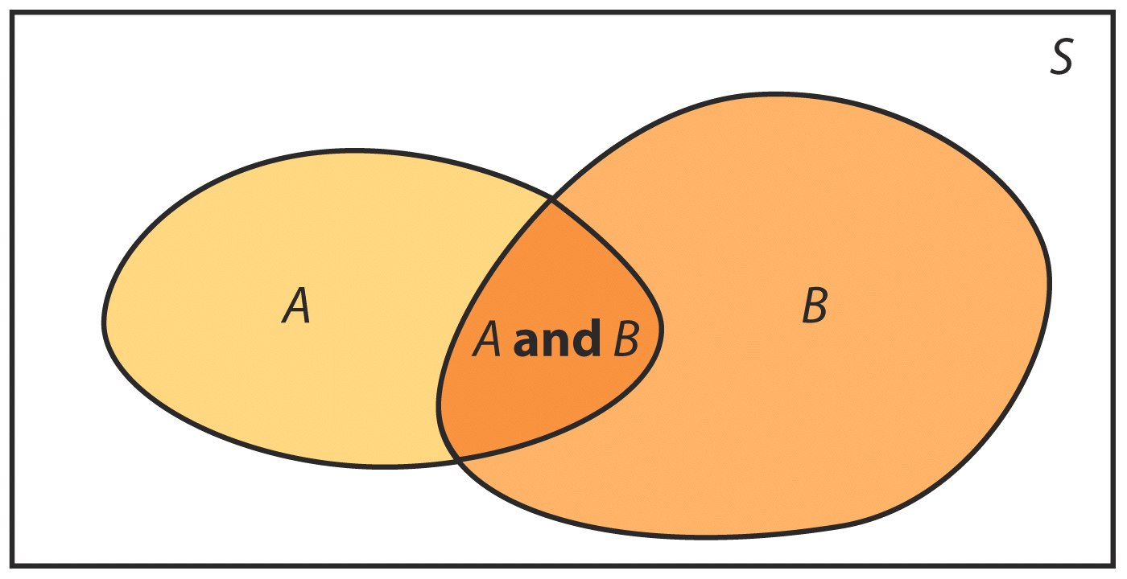
Venn Diagrams
Sometimes it is helpful to draw a picture to display relations among several events. A picture that shows the sample space S as a rectangular area and events as areas within S is called a Venn diagram.
Two events that are not disjoint, and the event {A and B} consisting of the outcomes they have in common:
Two disjoint events:

Slide 6
Multiplication Rule for
Independent Events
If two events A and B do not influence each other, and if knowledge about one does not change the probability of the other, the events are said to be independent of each other.
Multiplication Rule for Independent Events
Two events A and B are independent if knowing that one occurs does not change the probability that the other occurs. If A and B are independent:
P(A and B) = P(A) × P(B)

Slide 7
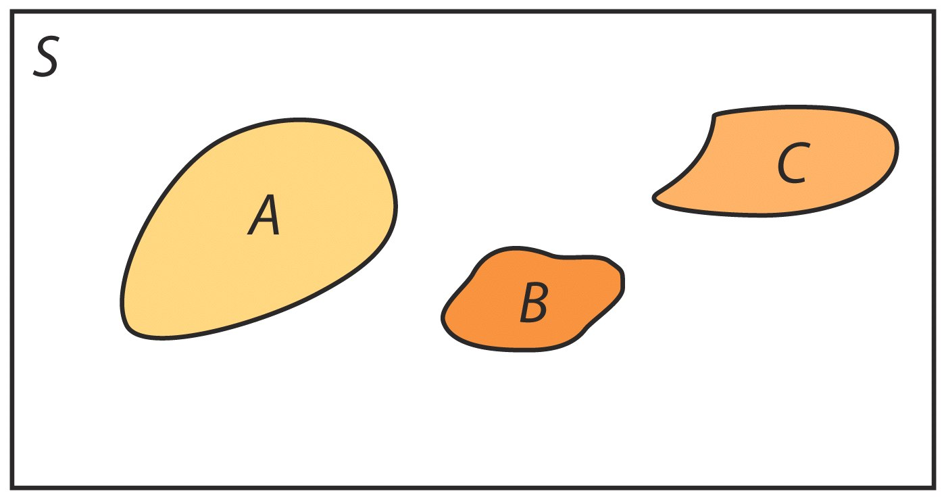
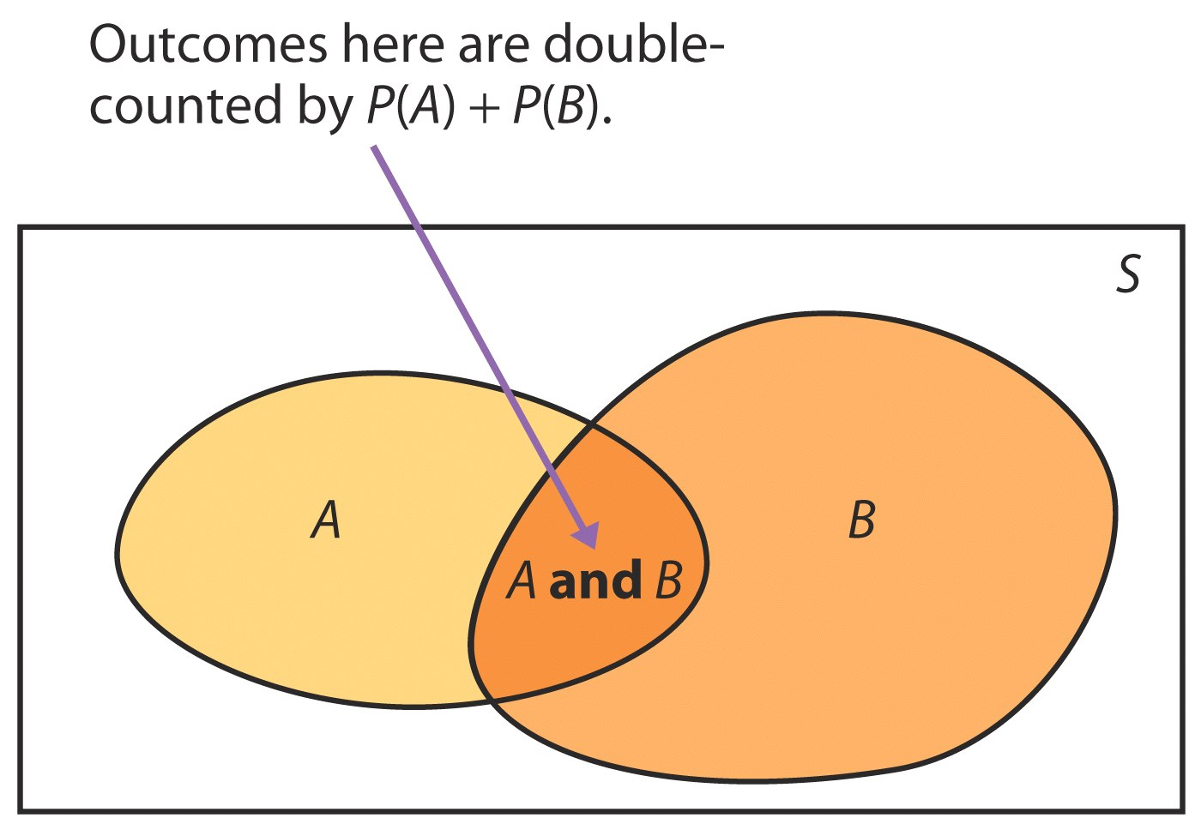
The General Addition Rule
We know if A and B are disjoint events,
P(A or B) = P(A) + P(B)
Addition Rule for Any Two Events
For any two events A and B:
P(A or B) = P(A) + P(B) – P(A and B)

Slide 8
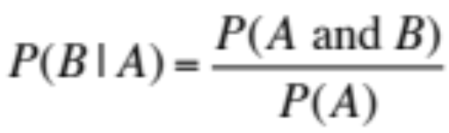
Conditional Probability
The probability we assign to an event can change if we know that some other event has occurred. This idea is the key to many applications of probability.
When we are trying to find the probability that one event will happen under the condition that some other event is already known to have occurred, we are trying to determine a conditional probability.
The probability that one event happens given that another event is already known to have happened is called a conditional probability.
When P(A) > 0, the probability that event B happens given that event A has happened is found by:

Slide 9
The General Multiplication Rule
The definition of conditional probability reminds us that in principle all probabilities, including conditional probabilities, can be found from the assignment of probabilities to events that describe a random phenomenon. The definition of conditional probability then turns into a rule for finding the probability that both of two events occur.
The probability that events A and B both occur can be found using the general multiplication rule
P(A and B) = P(A) • P(B | A)
where P(B | A) is the conditional probability that event B occurs given that event A has already occurred.
Note: Two events A and B that both have positive probability are independent if:
P(B|A) = P(B)

Slide 10
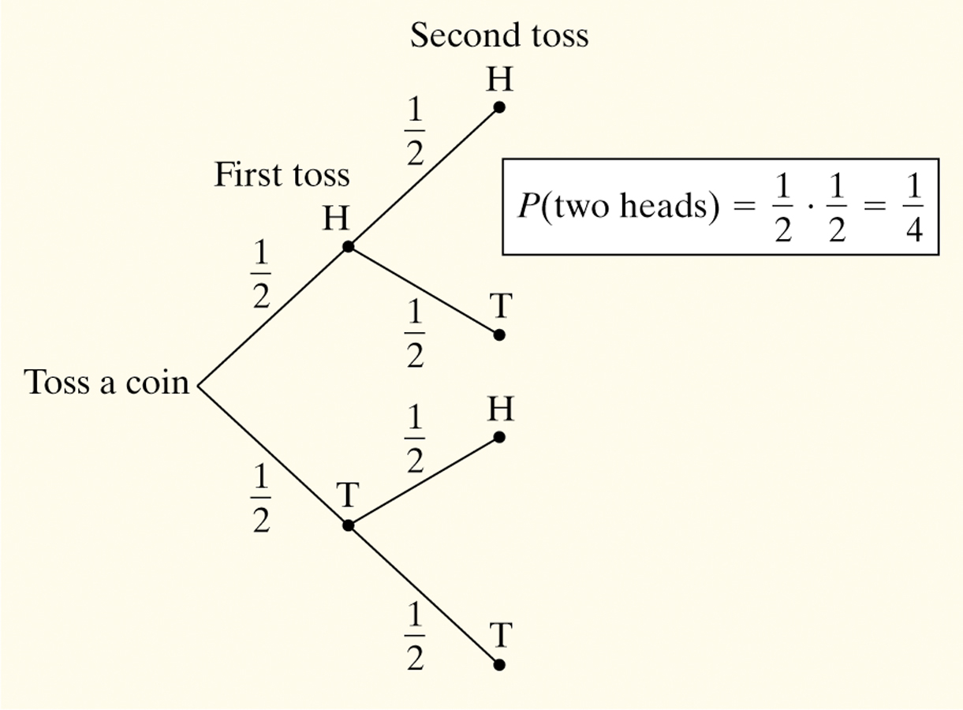
Tree Diagrams
We learned how to describe the sample space S of a chance process in Chapter 10. Another way to model chance behavior that involves a sequence of outcomes is to construct a tree diagram.
Consider flipping a coin twice.
What is the probability of getting two heads?
Sample Space:
HH HT TH TT
So, P(two heads) = P(HH) = 1/4

Slide 11

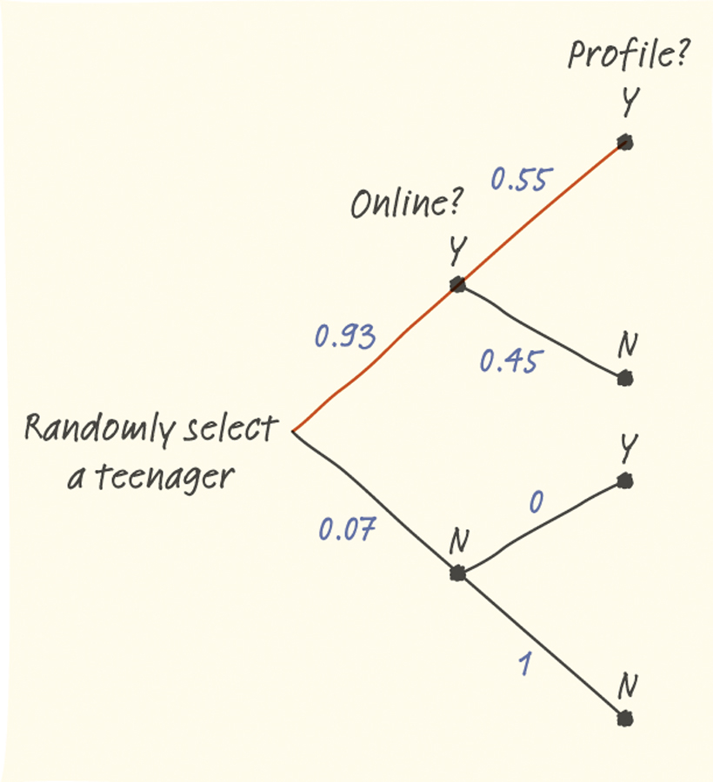
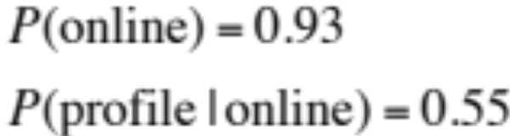
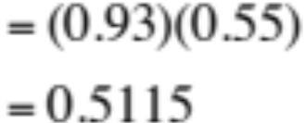
Example
The Pew Internet and American Life Project finds that 93% of teenagers (ages 12 to 17) use the Internet, and that 55% of online teens have posted a profile on a social-networking site.
What percent of teens are online and have posted a profile?
51.15% of teens are online and have posted a profile.

Slide 12
Chapter 12 Objectives Review
Define independent events
Determine whether two events are independent
Apply the general addition rule
Define conditional probability
Compute conditional probabilities
Apply the general multiplication rule
Describe chance behavior with a tree diagram

